Slide 1
Learning Objective
I will be able to apply the product rule
Success Criteria
At the end of the lesson, I will be able to:
Examine and use the product rule

Slide 2
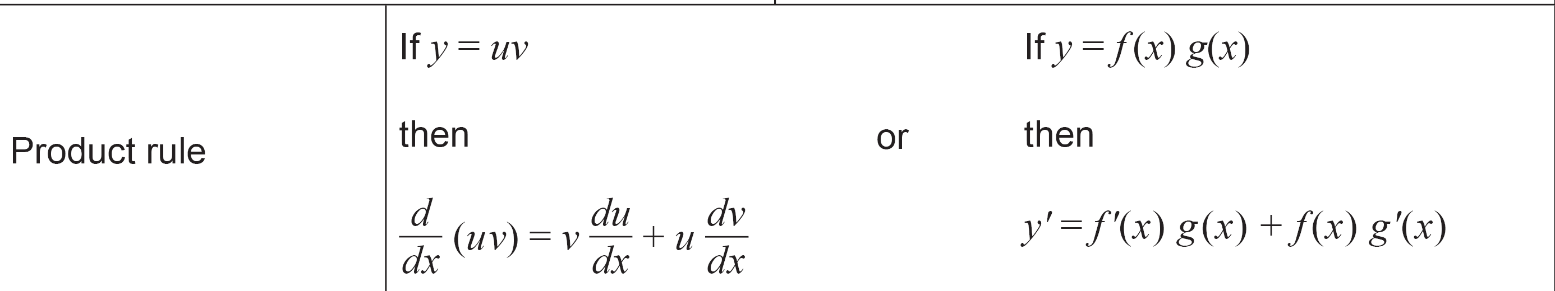

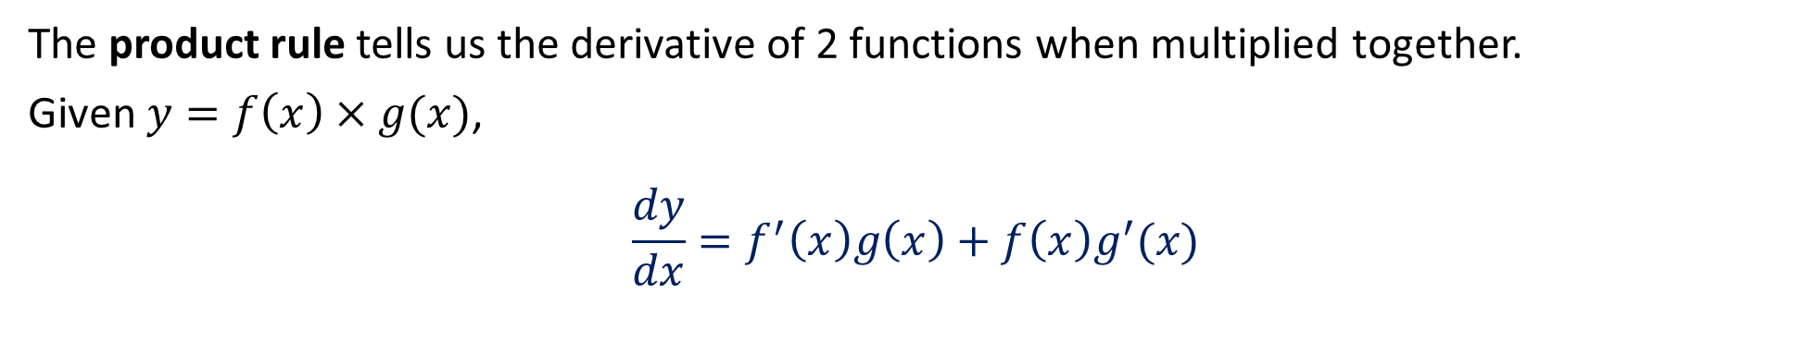

Product Rule
The product rule tells us the derivative of 2 functions when multiplied together.
Given $y=f\left(x\right)×g(x)$,
$$\frac{dy}{dx}=f^{′}\left(x\right)g\left(x\right)+f\left(x\right)g^{′}(x)$$
(Function Notation)
Given $y=uv,$
$$\frac{dy}{dx}=v\frac{du}{dx}+u\frac{dv}{dx}$$
(Leibniz Notation)
In Formula Sheet:

Slide 3
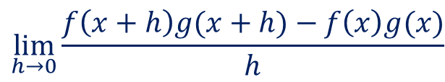
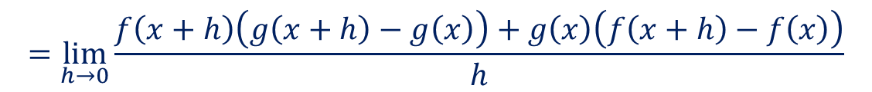
Proof (Optional)
Consider $y{=f\left(x\right)×g(x)}$ using first principles, prove that $\frac{dy}{dx}{=f^{′}\left(x\right)g\left(x\right)+f\left(x\right)g′(x)}$
$$\lim_{h→0}{\frac{f\left(x+h\right)g(x+h)−f\left(x\right)g(x)}{h}}$$
Add and subtract to the numerator $f\left(x+h\right)g(x)$
$$=\lim_{h→0}{\frac{f\left(x+h\right)g\left(x+h\right)−f\left(x+h\right)g\left(x\right)+f\left(x+h\right)g(x)−f\left(x\right)g(x)}{h}}$$
$$=\lim_{h→0}{\frac{f\left(x+h\right)\left(g\left(x+h\right)−g\left(x\right)\right)+g\left(x\right)\left(f\left(x+h\right)−f\left(x\right)\right)}{h}}$$
$$=\lim_{h→0}{\frac{f\left(x+h\right)\left(g\left(x+h\right)−g\left(x\right)\right)}{h}}+\lim_{h→0}{\frac{g\left(x\right)\left(f\left(x+h\right)−f\left(x\right)\right)}{h}}$$
$$=\lim_{h→0}{f\left(x+h\right)}\lim_{h→0}{\frac{\left(g\left(x+h\right)−g\left(x\right)\right)}{h}}+g\left(x\right)\lim_{h→0}{\frac{\left(f\left(x+h\right)−f\left(x\right)\right)}{h}}$$
$$=f\left(x\right)g′(x)+g\left(x\right)f′(x)$$

Slide 4

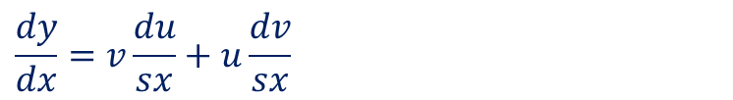
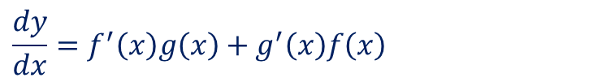
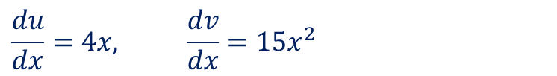
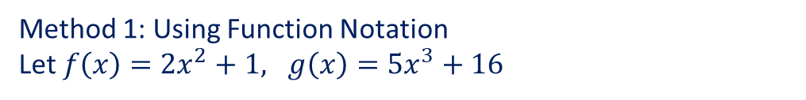
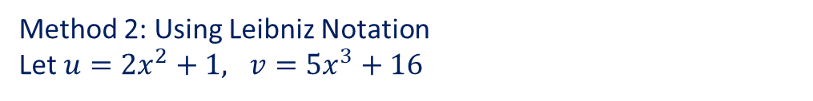
Guided Practice
Differentiate $y=\left(2x^{2}+1\right)\left(5x^{3}+16\right)$ with respect to $x$
Method 1: Using Function Notation
Let $f\left(x\right)=2x^{2}+1, g\left(x\right)=5x^{3}+16$
Method 2: Using Leibniz Notation
Let $u=2x^{2}+1, v=5x^{3}+16$
$$f^{′}\left(x\right)=4x, g^{′}\left(x\right)=15x^{2}$$
$$\frac{du}{dx}=4x, \frac{dv}{dx}=15x^{2}$$
$$\frac{dy}{dx}=f^{′}\left(x\right)g\left(x\right)+g^{′}\left(x\right)f\left(x\right)$$
$$\frac{dy}{dx}=v\frac{du}{sx}+u\frac{dv}{sx}$$
$$=4x\left(5x^{3}+16\right)+15x^{2}\left(2x^{2}+1\right)$$
$$=20x^{4}+64x+30x^{4}+15x^{2}$$
$$=4x\left(5x^{3}+16\right)+15x^{2}\left(2x^{2}+1\right)$$
$$=50x^{4}+15x^{2}+64x$$
$$=20x^{4}+64x+30x^{4}+15x^{2}$$
$$=50x^{4}+15x^{2}+64x$$

Slide 5
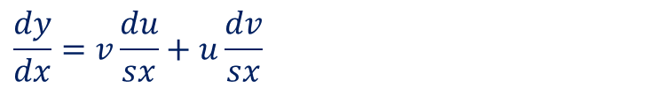

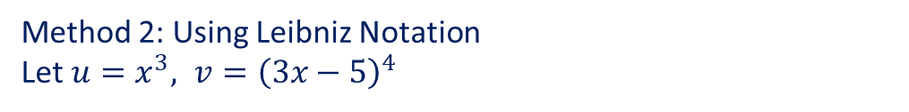

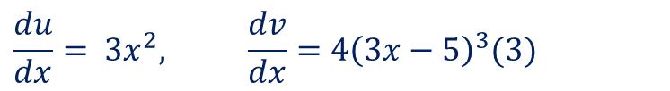
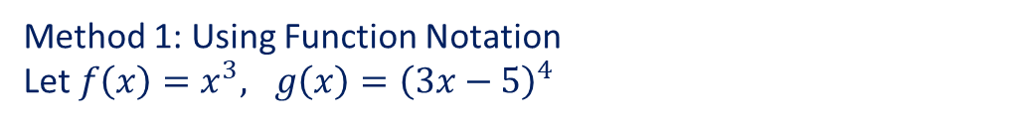

Guided Practice
Differentiate $y=x^{3}{\left(3x−5\right)}^{4}$ with respect to $x$
Method 1: Using Function Notation
Let $f\left(x\right)=x^{3}, g\left(x\right)={\left(3x−5\right)}^{4}$
Method 2: Using Leibniz Notation
Let $u=x^{3}, v={\left(3x−5\right)}^{4}$
$$f^{′}\left(x\right)=3x^{2}, g^{′}\left(x\right)=4{\left(3x−5\right)}^{3}(3)$$
$$=12{\left(3x−5\right)}^{3}$$
$$\frac{du}{dx}= 3x^{2}, \frac{dv}{dx}=4{\left(3x−5\right)}^{3}(3)$$
$$\frac{dy}{dx}=f^{′}\left(x\right)g\left(x\right)+g^{′}\left(x\right)f\left(x\right)$$
$$=12{\left(3x−5\right)}^{3}$$
$$=3x^{2}{\left(3x−5\right)}^{4}+{\left(x\right)}^{3}(12){\left(3x−5\right)}^{3}$$
$$\frac{dy}{dx}=v\frac{du}{sx}+u\frac{dv}{sx}$$
$$=3x^{2}{\left(3x−5\right)}^{3}\left(3x−5+4x\right)$$
$$=3x^{2} \left(7x−5\right){\left(3x−5\right)}^{3}$$
$$=3x^{2}{\left(3x−5\right)}^{4}+{\left(x\right)}^{3}(12){\left(3x−5\right)}^{3}$$
$$=3x^{2}{\left(3x−5\right)}^{3}\left(3x−5+4x\right)$$
$$=3x^{2} \left(7x−5\right){\left(3x−5\right)}^{3}$$

Slide 6


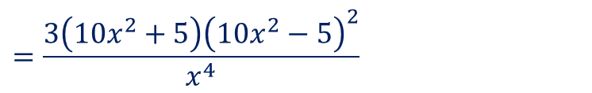


Guided Practice
Given $F\left(x\right)=x^{−3}{\left(10x^{2}−5\right)}^{3}, \left\{x∈ℝ:x≠0\right\},$ determine $F′\left(x\right)$
Let $f\left(x\right)=x^{−3}, g\left(x\right)={\left(10x^{2}−5\right)}^{3}$
$$f^{′}\left(x\right)=−3x^{−4}, g^{′}\left(x\right)=3{\left(10x^{2}−5\right)}^{2}\left(20x\right)$$
$$=60x{\left(10x^{2}−5\right)}^{2}$$
$$\frac{dy}{dx}=f^{′}\left(x\right)g\left(x\right)+g^{′}\left(x\right)f\left(x\right)$$
$$=−3x^{−4}{\left(10x^{2}−5\right)}^{3}+x^{−3}\left(60x\right){\left(10x^{2}−5\right)}^{2}$$
$$=3x^{−4}{\left(10x^{2}−5\right)}^{2}\left[−\left(10x^{2}−5\right)+20x^{2}\right]$$
$$=3x^{−4}{\left(10x^{2}−5\right)}^{2}\left(10x^{2}+5\right)$$
$$=\frac{3\left(10x^{2}+5\right){\left(10x^{2}−5\right)}^{2}}{x^{4}}$$

Slide 7

Guided Practice
Differentiate $y=e^{x}\left(2x^{2}+1\right)$with respect to $x$
Let $f\left(x\right)=e^{x}, g\left(x\right)=\left(2x^{2}+1\right)$
$$f^{′}\left(x\right)=e^{x}, g^{′}\left(x\right)=4x$$
$$\frac{dy}{dx}=f^{′}\left(x\right)g\left(x\right)+g^{′}\left(x\right)f\left(x\right)$$
$$=e^{x}\left(2x^{2}+1\right)+e^{x}4x$$
$$=e^{x}\left(2x^{2}+4x+1\right)$$

Slide 8
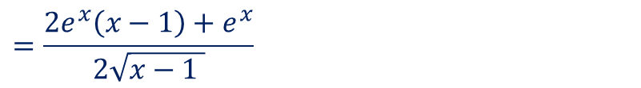
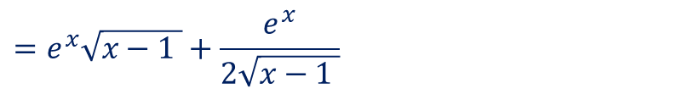

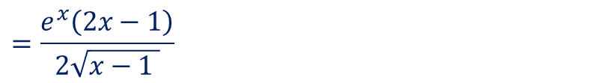
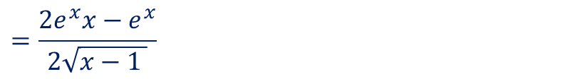
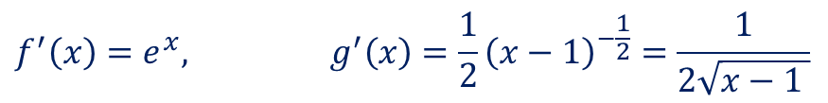
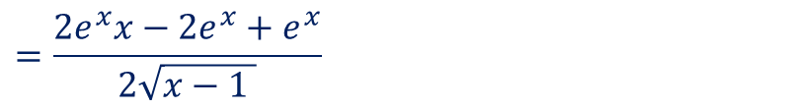
Guided Practice
Differentiate $y=e^{x}\sqrt{x−1}$with respect to $x$
Let $f\left(x\right)=e^{x}, g\left(x\right)=\sqrt{x−1 }={\left(x−1\right)}^{\frac{1}{2}}$
$$f^{′}\left(x\right)=e^{x}, g^{′}\left(x\right)=\frac{1}{2}{\left(x−1\right)}^{−\frac{1}{2}}=\frac{1}{2\sqrt{x−1 }}$$
$$\frac{dy}{dx}=f^{′}\left(x\right)g\left(x\right)+g^{′}\left(x\right)f\left(x\right)$$
$$=e^{x}\sqrt{x−1 }+\frac{e^{x}}{2\sqrt{x−1 }}$$
$$=\frac{2e^{x}\left(x−1\right)+e^{x}}{2\sqrt{x−1 }}$$
$$=\frac{2e^{x}x−2e^{x}+e^{x}}{2\sqrt{x−1 }}$$
$$=\frac{2e^{x}x−e^{x}}{2\sqrt{x−1 }}$$
$$=\frac{e^{x}\left(2x−1\right)}{2\sqrt{x−1 }}$$

Slide 9
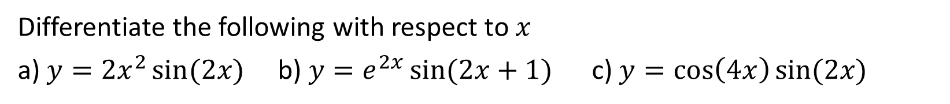
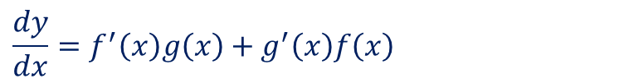


Guided Practice
Differentiate the following with respect to $x$
a) $y=2x^{2}\sin{(2x)}$ b) $y=e^{2x}\sin{(2x+1)}$ c) $y=\cos\left(4x\right)\sin{(2x)}$
a) Let $f\left(x\right)=2x^{2}, g\left(x\right)=\sin\left(2x\right)$
$$f^{′}\left(x\right)=4x, g^{′}\left(x\right)=2\cos\left(2x\right)$$
b) Let $f\left(x\right)=\cos\left(4x\right), g\left(x\right)=\sin\left(2x\right)$
$$f^{′}\left(x\right)=−4\sin\left(4x\right), g′(x)=2\cos\left(2x\right)$$
$$\frac{dy}{dx}=f^{′}\left(x\right)g\left(x\right)+g^{′}\left(x\right)f\left(x\right)$$
$$\frac{dy}{dx}=f^{′}\left(x\right)g\left(x\right)+g^{′}\left(x\right)f\left(x\right)$$
$$=4x\sin\left(2x\right)+4x^{2}\cos\left(2x\right)$$
b) Let $f\left(x\right)=e^{2x}, g\left(x\right)=\sin\left(2x+1\right)$
$$=−4\sin\left(4x\right)\sin\left(2x\right)+2\cos\left(2x\right)\cos{(4x)}$$
$$f^{′}\left(x\right)=2 e^{2x}, g^{′}\left(x\right)=2\cos\left(2x+1\right)$$
$$\frac{dy}{dx}=f^{′}\left(x\right)g\left(x\right)+g^{′}\left(x\right)f\left(x\right)$$
$$=2 e^{2x}\sin\left(2x+1\right)+2 e^{2x}\cos\left(2x+1\right)$$
$$=2 e^{2x}\left[\sin\left(2x+1\right)+\cos\left(2x+1\right)\right]$$

Slide 10
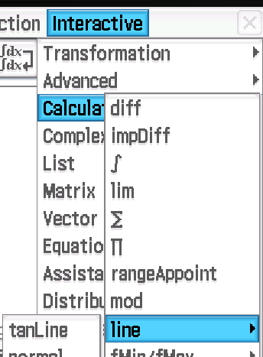
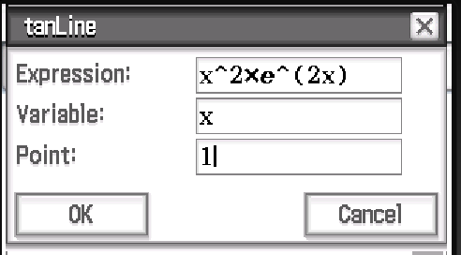
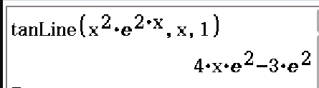





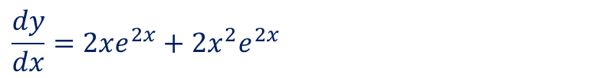



Guided Practice
Determine the equation of tangent to the graph $f\left(x\right)=x^{2}e^{2x}, at x=1$
Subst $x=1 into f\left(x\right), f\left(1\right)=1^{2}×e^{2}=e^{2}$
The tangent passes through the points $(1, e^{2})$
$$\frac{dy}{dx}=2xe^{2x}+2x^{2}e^{2x}$$
Subst. $x=1 into \frac{dy}{dx}, \frac{dy}{dx}=2e^{2}+2e^{2}=4e^{2}$
Tangent of line $y=4e^{2}x+c$
Subst $(1, e^{2})$ into $y, e^{2}=4e^{2}+c$
$$c=−3e^{2}$$
Tangent of line $y=4e^{2}x−3e^{2}$

Slide 11


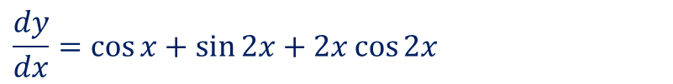


Guided Practice
Determine the equation of tangent to the graph $y=\sin{x}+x\sin{(2x)} , at x=0$
Subst $x=0 into y, y=\sin{(0)}+0\sin{(0)}=0$
The tangent passes through the points $(0,0)$
$$\frac{dy}{dx}=\cos{x}+\sin{2x}+2x\cos{2x}$$
Subst. $x=0 into \frac{dy}{dx}, \frac{dy}{dx}=\cos{0}+\sin{0}+2\left(0\right)\cos{0}=1$
Tangent of line $y=x+c$
Subst $(0,0)$ into $y, c=0$
Tangent of line $y=x$

Slide 12

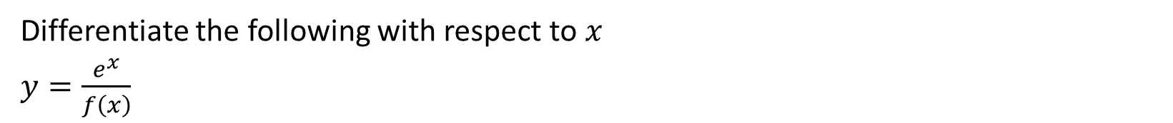
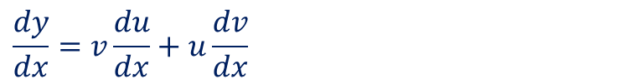
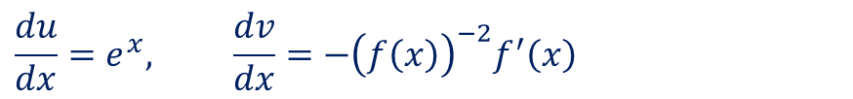
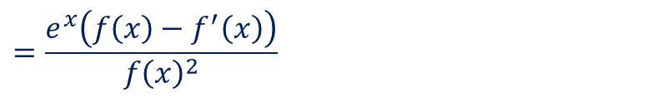
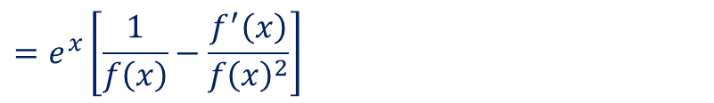
Guided Practice
Differentiate the following with respect to $x$
$y=\frac{e^{x}}{f\left(x\right)}$
Rewrite $y=e^{x}{\left(f\left(x\right)\right)}^{−1}$
Let $u=e^{x}, v={\left(f\left(x\right)\right)}^{−1}$
$$\frac{du}{dx}=e^{x}, \frac{dv}{dx}=−{\left(f\left(x\right)\right)}^{−2}f^{′}\left(x\right)$$
$$\frac{dy}{dx}=v\frac{du}{dx}+u\frac{dv}{dx}$$
$$=e^{x}{\left(f\left(x\right)\right)}^{−1}−e^{x}{\left(f\left(x\right)\right)}^{−2}f^{′}\left(x\right)$$
$$=e^{x}\left[\frac{1}{f\left(x\right)}−\frac{f^{′}\left(x\right)}{f{\left(x\right)}^{2}}\right]$$
$$=\frac{e^{x}\left(f\left(x\right)−f^{′}\left(x\right)\right)}{f{\left(x\right)}^{2}}$$

Slide 13

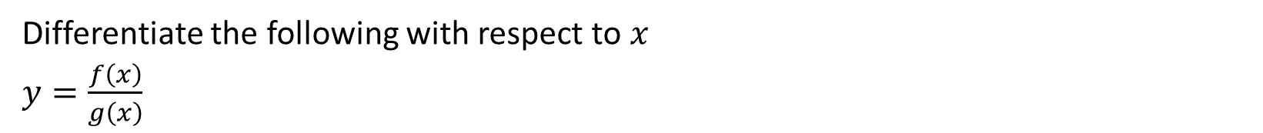


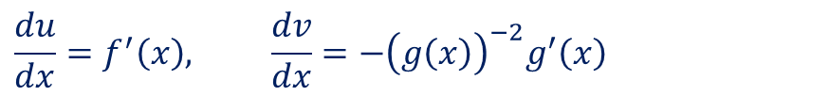
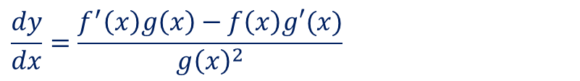
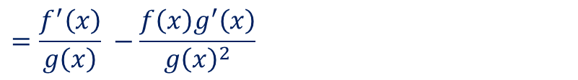
Guided Practice
Differentiate the following with respect to $x$
$y=\frac{f\left(x\right)}{g\left(x\right)}$
How would this be represented in Leibniz notation?
Rewrite $y=f(x){\left(g\left(x\right)\right)}^{−1}$
Let $u=f(x), v={\left(g\left(x\right)\right)}^{−1}$
If $y=\frac{u}{v},$ where $u$ and $v$ are functions of $x$
$$\frac{du}{dx}=f^{′}\left(x\right), \frac{dv}{dx}=−{\left(g\left(x\right)\right)}^{−2}g^{′}\left(x\right)$$
$$\frac{dy}{dx}=\frac{v\frac{du}{dx}−u\frac{dv}{dx}}{v^{2}}$$
$$\frac{dy}{dx}=v\frac{du}{dx}+u\frac{dv}{dx}$$
$$=f′\left(x\right){\left(g\left(x\right)\right)}^{−1}−{\left(g\left(x\right)\right)}^{−2}g^{′}\left(x\right)f(x)$$
$$=\frac{f^{′}\left(x\right)}{g\left(x\right)} −\frac{f\left(x\right)g^{′}\left(x\right)}{g{\left(x\right)}^{2}}$$
$$\frac{dy}{dx}=\frac{f^{′}\left(x\right)g\left(x\right)−f\left(x\right)g′(x)}{g{\left(x\right)}^{2}}$$
(Quotient Rule in function notation)

Slide 14
Independent Practice
Complete Cambridge Ex 4J Except Q3

